Slide 1
Variable reordering strategies for SLAM
Pratik Agarwal and Edwin Olson
University of Freiburg and University of Michigan
Notes:
Adjust Note size

Slide 2
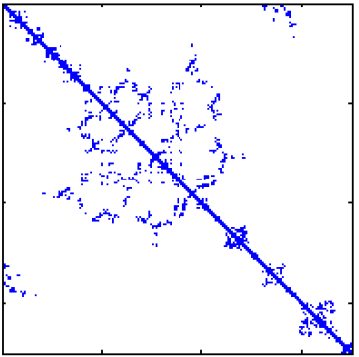
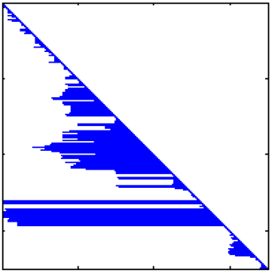
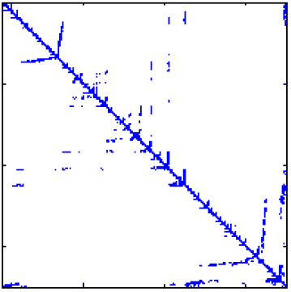
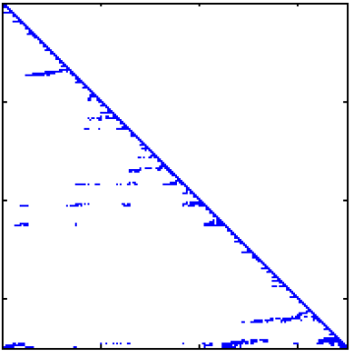
Graph based SLAM
Linearized system of constraints $Ax=b$
Bad
ordering
24 times more zeros
Good
ordering
Notes:
All Graph based slam Ax=b
X-> unknown robot and feature position
matrix decomposition much faster than inverting
if A and L are sparse
A->typically sparse for slam problems
L->depends on ordering
click
Bad ordering destroys the sparsity of L though A had same to begin with
Both As contain exactly same – just “shuffled”

Slide 3
Graph based SLAM
Linearized system of constraints $Ax=b$
Reorder
Notes:
Reordering is basically changing the order of inference in x
To do you shuffle A keeping exactly same information

Slide 4
Reordering
$$..x + ..y + ..z=.. \\ ..x + ..y + ..z=.. \\ ..x + ..y + ..z=..$$
$$x \\ y \\ z$$
$$x \\ z \\ y$$
=
=
Reordering the variables $x,y,z$

Slide 5
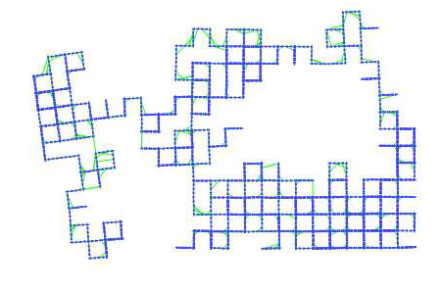
Reordering is essential for SLAM
Bad ordering
10s
Good ordering
0.1s
Good ordering
100 times faster
Notes:
3500 robot position
Reordering can be difference between online and offline performance
click
NP hard
heuristics which work quite well
What ever reordering same solution

Slide 6
Contribution
Find best state-of-art method
A simple easy alternative
All methods compute identical $x$
Notes:
Attempt to find best ordering strategy for SLAM problems
By evaluating lots of datasets
Simple ordering strategy if one doesnot want dependency on libraries due to licensing issues
Since lot state of the art methods including BHAMD approximate EMD lets see what it does

Slide 7
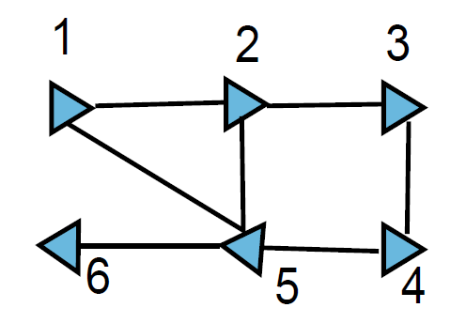
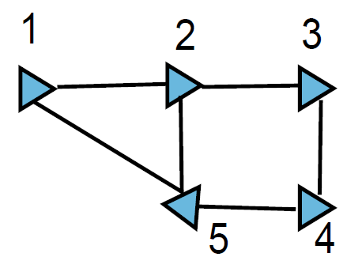
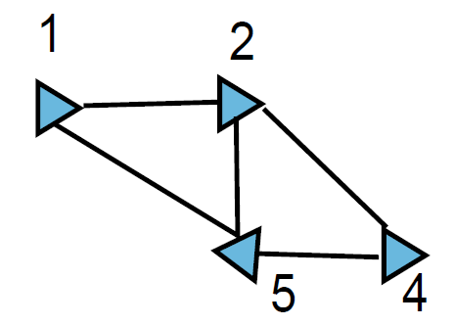
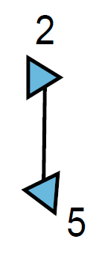
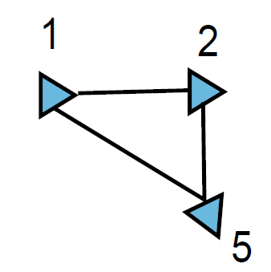
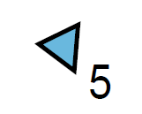
Exact minimum degree (EMD)
Remove node with min edges
Connect neighbors
Notes:
Key idea -> more connected – high node degree nodes will be pushed to the end of the ordering
Consider a toy example of 6 robot positions

Slide 8
Our method: bucket heap AMD
Advantage over EMD:
Single query - multiple vertex elimination
How?
Lists of vertices with similar #edges

Slide 9
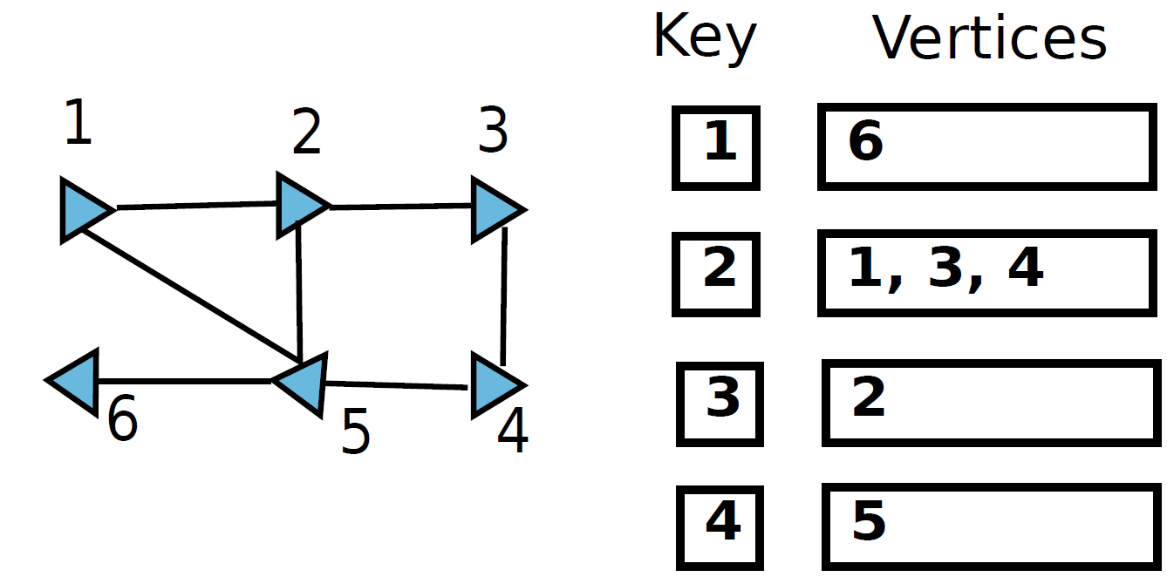
BHAMD in action
Notes:
Initialize a heap with lists containing vertices with identical mode degree

Slide 10
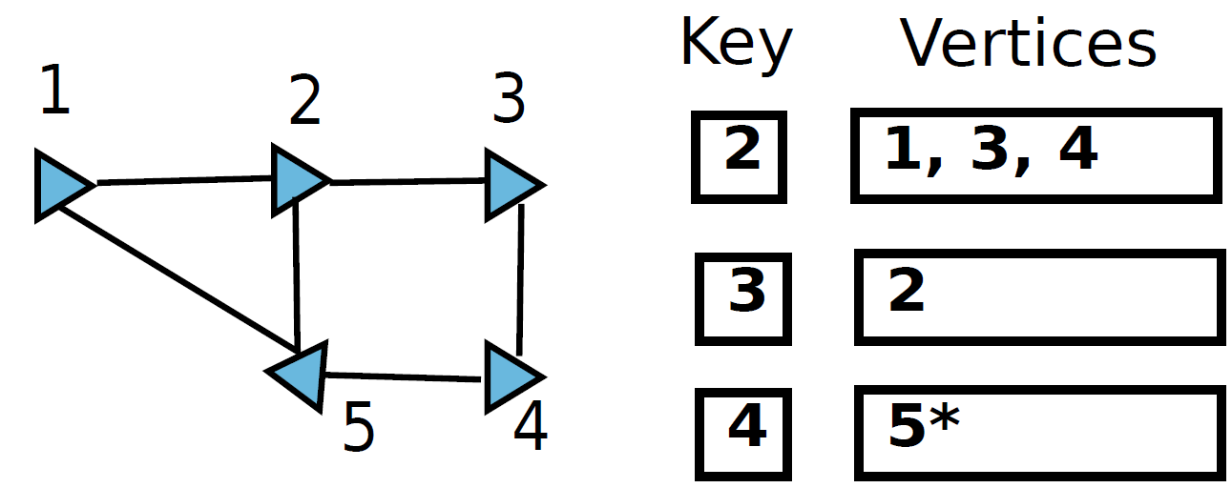
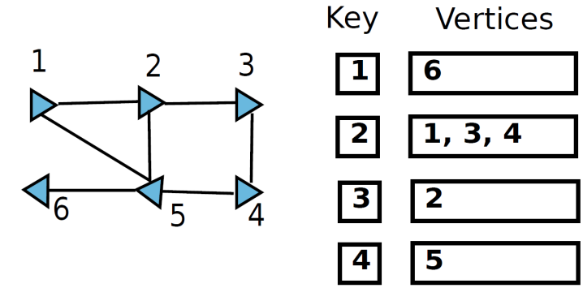
BHAMD in action
Notes:
We pop the list with mininum key value and evaluate vertices

Slide 11
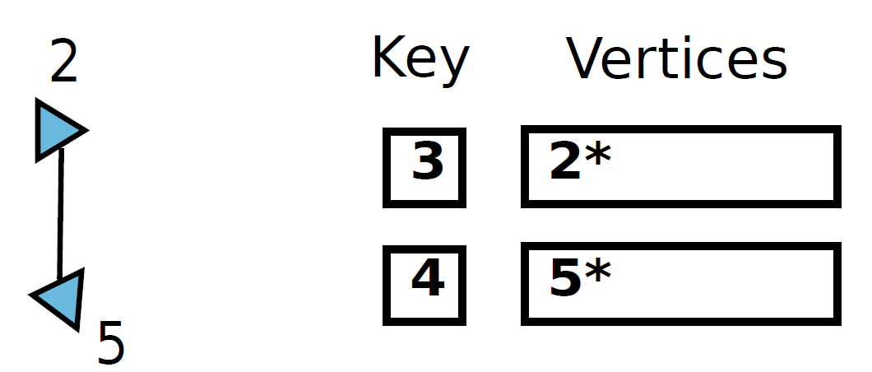
BHAMD in action
Notes:
Expect a question on MMD – read it once
Read the heuristc for AMD and COLAMD and NESDIS once

Slide 12
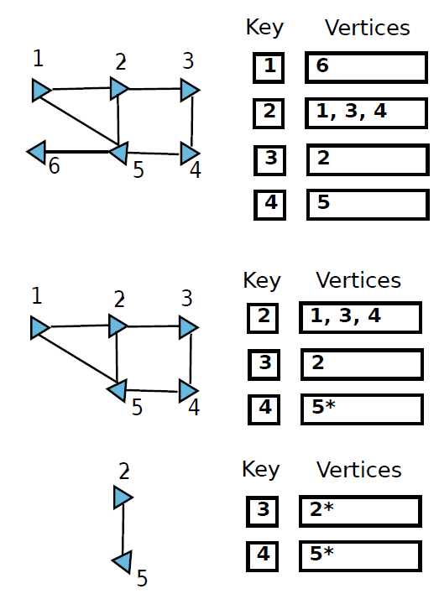
BHAMD in action
Multiple vertices eliminated
Notes:
BHAMD and EMD different ordering
BHAMD doesn’t provide same ordering as EMD because occasionally a vertice with node degree slightly > the current min degree will get eliminated

Slide 13
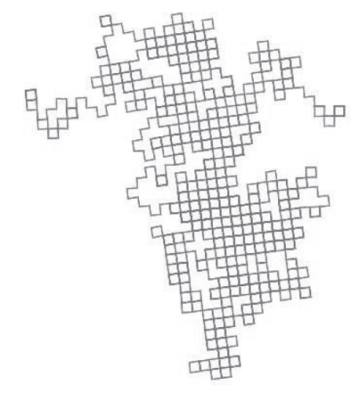
BHAMD on a 10,000 node graph
EMD - 10,000 steps
BHAMD - 107 steps
Max heap size in BHAMD 42
Notes:
at any point of time 42 unique node degrees

Slide 14
State-of-the-art techniques
AMD Approximate Minimum Degree
COLAMD Column Approximate Minimum Degree
NESDIS Nested Dissection
METIS Serial Graph Partition
Notes:
Datasets: w1000, city10000, manhattan3500, vp, intel, killian, magic multi robot

Slide 15
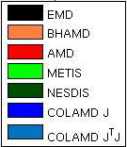
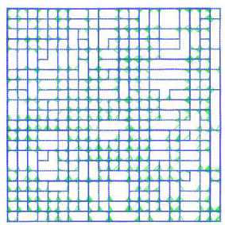
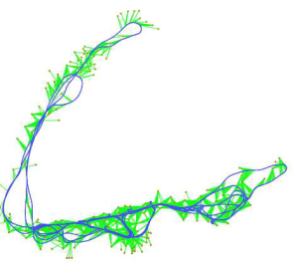
Evaluation – reordering time
EMD is slowest
Notes:
Time to find the order for shuffling

Slide 16
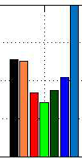
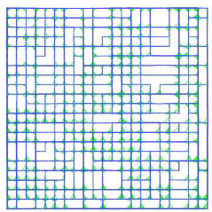
Evaluation – solve time
COLAMD on $A$ is slowest
Notes:
Solve time = finding L and x after reordering the matrix
All method same solution – difference fill-in different time

Slide 17
Further room for improvement?
Ideally
consider all possible orderings
1000 nodes ${10}^{2567}$ orderings
Instead
Local changes in existing orderings
maximum improvement of 0.5%
(with 1 week compute time)
Notes:
Can EMD based algorithms perform significantly better results
Instead -> took the ordering from EMD and AMD and performed a kind of genetic search
Swaps and kept continuing till the ordering produced 10% more fill in and restarted it..
We believe no room for mprovement for EMD based algorithms

Slide 18
Conclusion
All methods comparable EMD & COLAMD on A
BHAMD - simple yet competitive
Negligible improvement with small changes
Notes:
BHAMD can easily be implemented
BHAMD no dependency on math libraries Licensing issues etc
We believe no further room for improvement for heuristics based only on EMD

Slide 19
Questions

Slide 20
Reordering matrix - P
$$Ax=b \\ \left(PA\right)x_{p}=Pb \\ x=P^{−1}x_{p}$$
$P^{−1}$ is easy, since $P^{−1}=P^{T}$
Computing the best reordering matrix P is NP hard
Heuristics work quite well

Slide 21
Toy example
Bad
ordering
Good
ordering

Slide 22
Multiple Min Degree (MMD) vs BHAMD
Similarity
multiple elimination
Difference
MMD computes and eliminates independent nodes
MMD is still exact unlike BHAMD

Slide 23
But I use CSparse with COLAMD
It calls AMD if the matrix is PSD
Be careful when opening the box

Slide 24
Graph based SLAM
Linearized system of constraints $Ax=b$
Bad
ordering
Good
ordering
24 times sparser
Notes:
Both As contain exactly same – just “shuffled”
Reordering is basically changing the order of delta x..
To do you shuffle A keeping exactly same information
Simply saying reordering is the order of elimination and substitution in standard algebra..
This is nothing new
Matlab CSPARSE G2O ceres

