Slide 1
Dynamic Covariance Scaling for Robust Robot Mapping
Workshop on Robust and
Multimodal Inference in Factor Graphs
Pratik Agarwal, Gian Diego Tipaldi, Luciano Spinello, Cyrill Stachniss and Wolfram Burgard
University of Freiburg, Germany

Slide 2
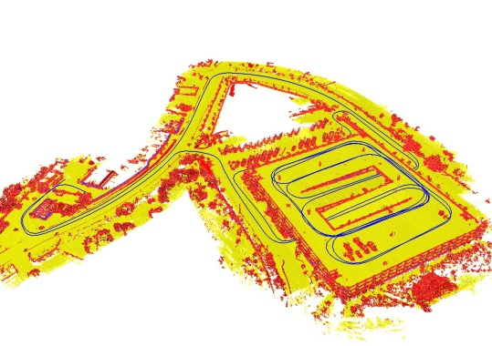
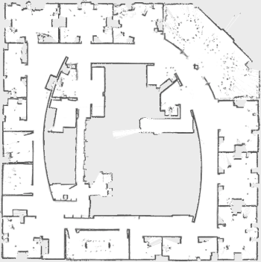
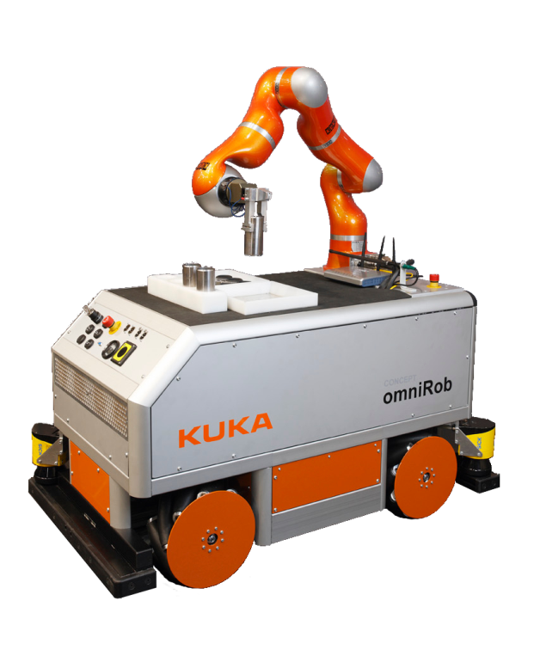
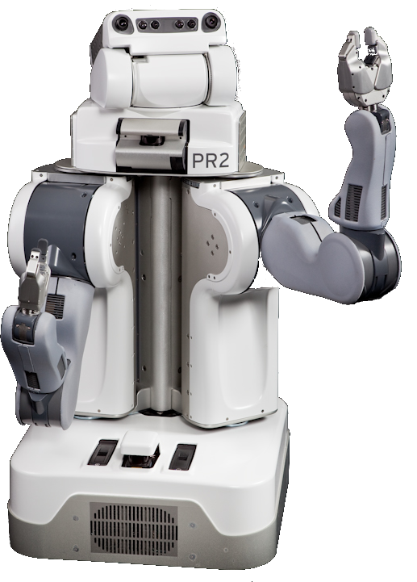
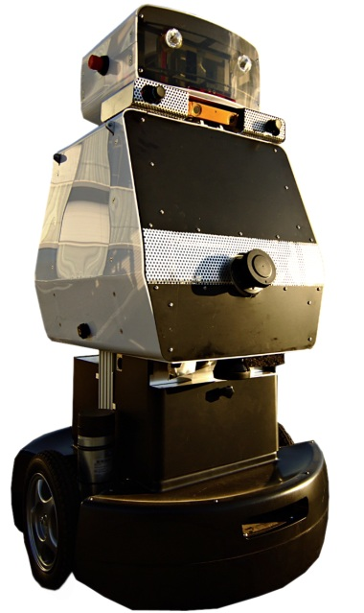
Maps are Essential for Effective Navigation

Slide 3
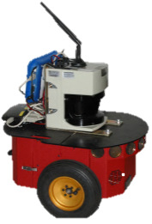
Graph-based SLAM
Robot pose
Constraint

Slide 4
Graph-based SLAM
Robot pose
Constraint

Slide 5
Graph-based SLAM
Robot pose
Constraint
Landmark
Notes:
\

Slide 6
Graph-based SLAM
Robot pose
Constraint
Landmark
Notes:
\

Slide 7
Graph-based SLAM
Robot pose
Constraint
a single outlier …
Notes:
\

Slide 8
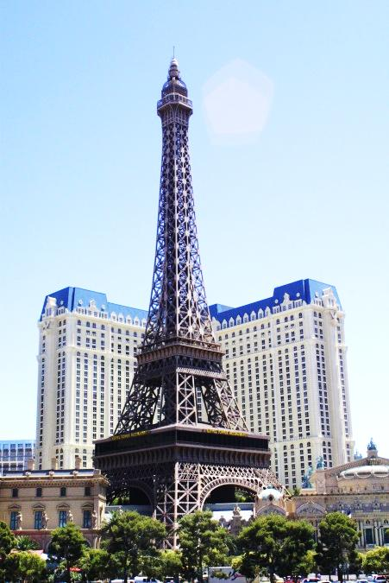
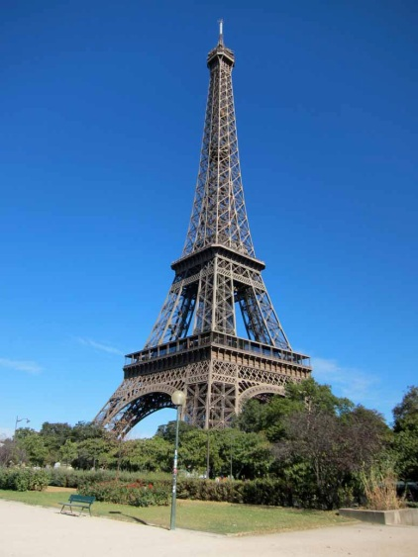
Graph-based SLAM
Robot pose
Constraint
a single outlier …

Slide 9
Graph-based SLAM
Vegas!!
Robot pose
Paris!!
Constraint
a single outlier …

Slide 10
Graph-based SLAM
Robot pose
Constraint
a single outlier … ruins the map

Slide 11
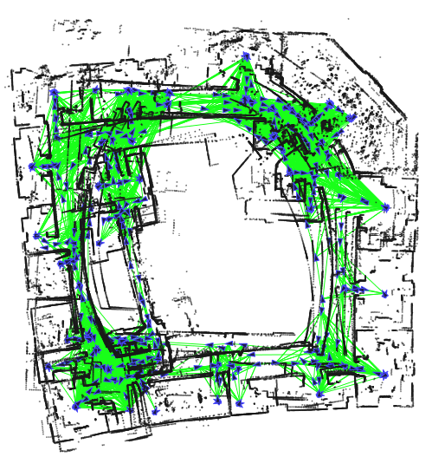
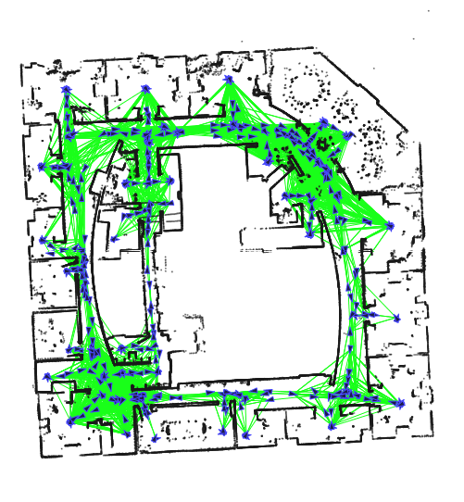
Graph-SLAM Pipeline
Front end Validation Back end
Assumption:
No
Outliers
Impossible to have perfect validation

Slide 12
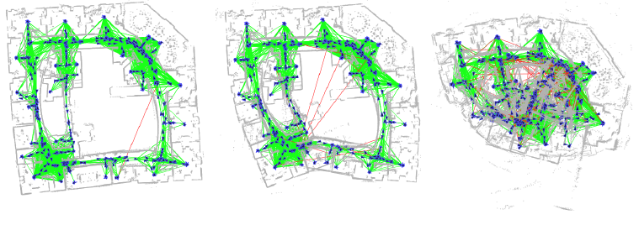
SLAM Back End Fails in the Presence of Outliers
1
Outlier
10
Outliers
100
Outliers
1
Outlier
10
Outliers

Slide 13
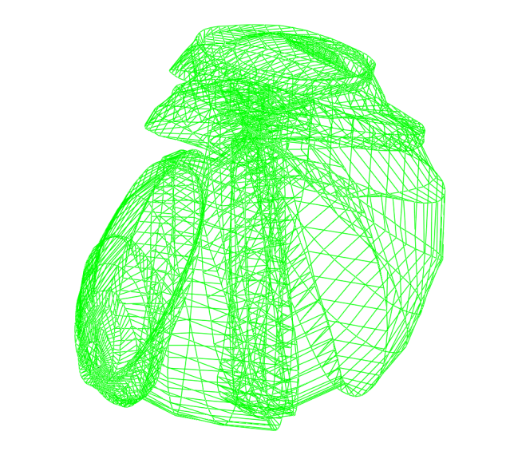
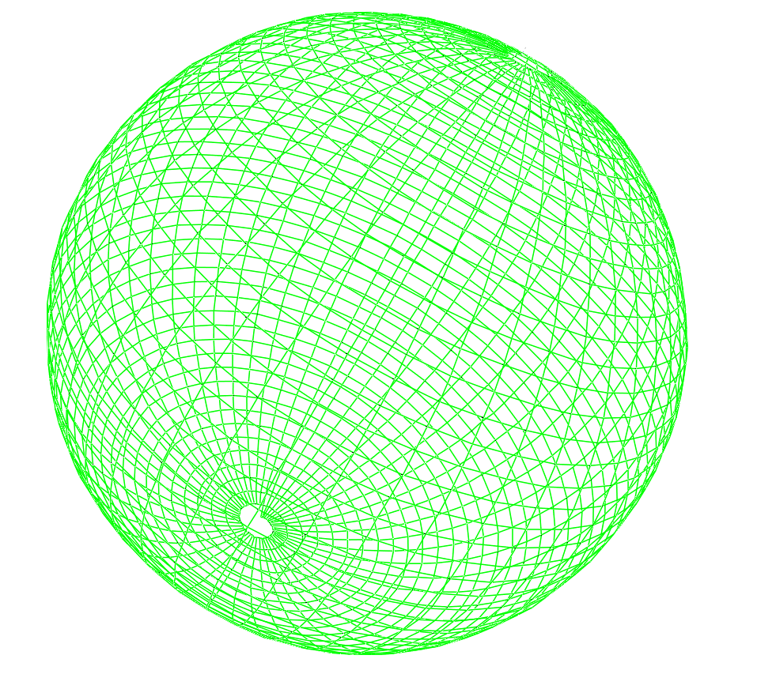
SLAM Back End Depends on the Initial Guess
Good
Initial
Guess

Slide 14
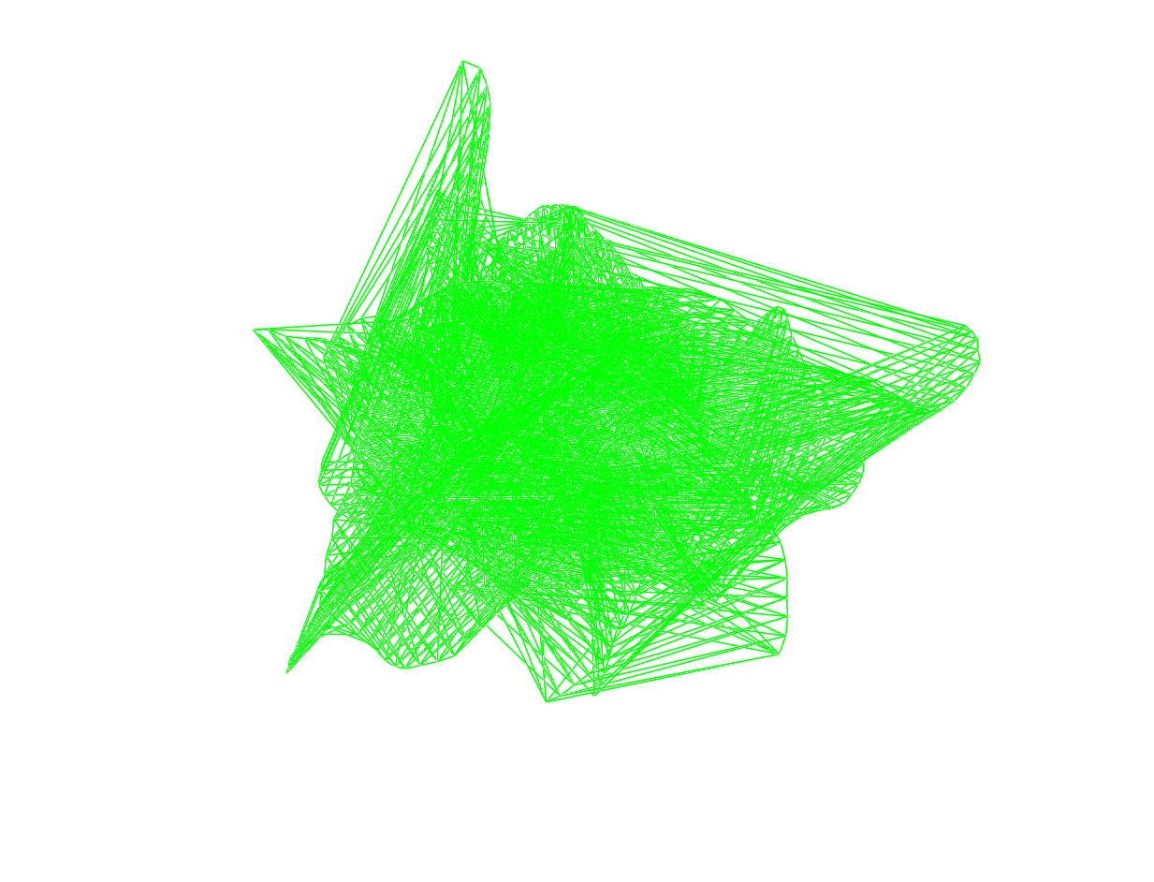
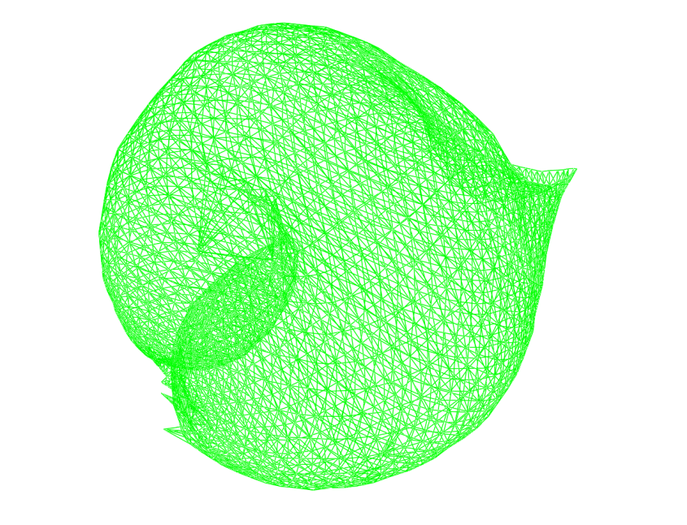
SLAM Back End Depends on the Initial Guess
Good
Initial
Guess
Bad
Initial
Guess

Slide 15
Typical Assumptions
Gaussian assumption is violated
Perceptual aliasing
Measurement error
Multipath GPS measurements

Slide 16
Typical Assumptions
Gaussian assumption is violated
Perceptual aliasing
Measurement error
Multipath GPS measurements
Linear approximation is invalid
Linearization is only valid if close to optimum

Slide 17
Typical Assumptions in Graph-SLAM
No outliers
Good initial guess
Current methods both independently
Our method approaches both problems

Slide 18
Typical Assumptions in Graph-SLAM
No outliers
Good initial guess
Current methods solve both independently
Our method approaches both problems
Our Approach
Dynamic Covariance Scaling

Slide 19
Our Approach: Dynamic Covariance Scaling
Successfully rejects outliers
More robust to bad initial guess
Does not increase state space
Is a robust M-estimator

Slide 20
Standard Gaussian Least Squares

Slide 21
Dynamic Covariance Scaling

Slide 22
How to Determine s?

Slide 23
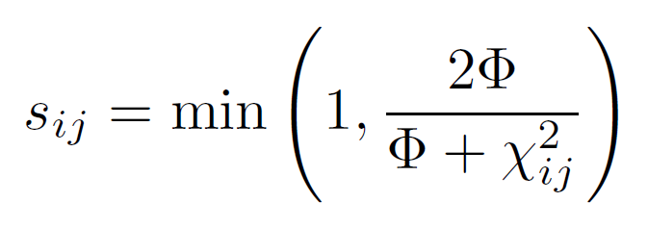
How to Determine s?
. . .
Closed form approximation of Switchable Constraints with a M-estimator

Slide 24
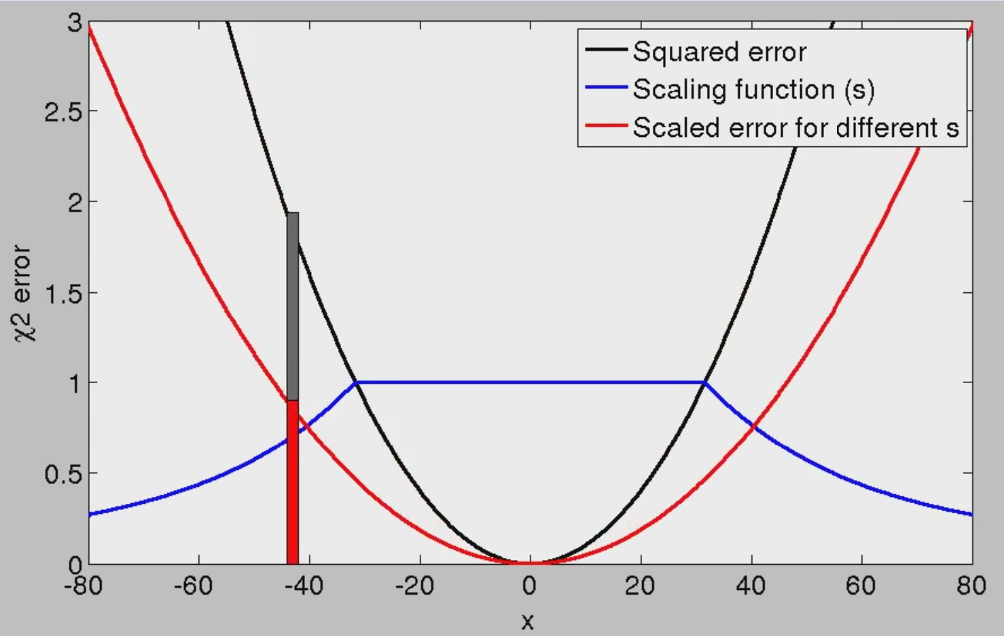
Dynamic Covariance Scaling

Slide 25
Dynamic Covariance Scaling
Original
error
Scaled
error

Slide 26
Dynamic Covariance Scaling
Linearization

Slide 27
Dynamic Covariance Scaling

Slide 28
Robust SLAM with Our Method
Ground
Truth
Initialization
Gauss
Newton
Our
Method
Sphere2500
(1000 Outiers)
Manhattan3500
(1000 Outiers)

Slide 29
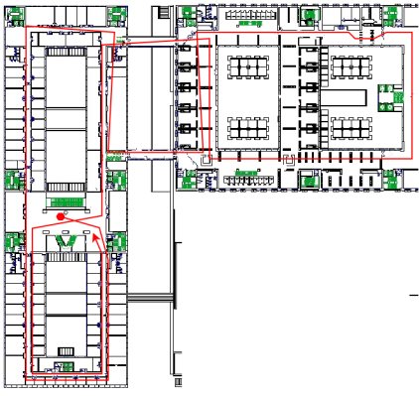
Dynamic Covariance Scaling with Front-end Outliers
Bicocca multisession dataset

Slide 30
Dynamic Covariance Scaling with Front-end Outliers
Lincoln-labs multisession dataset

Slide 31
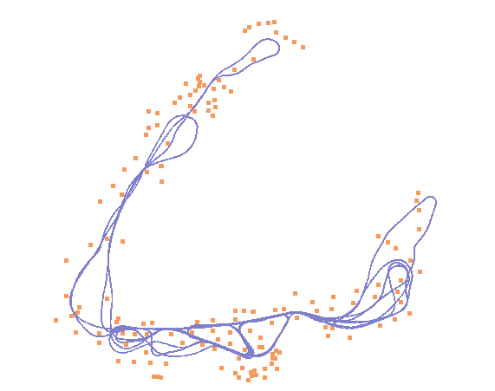
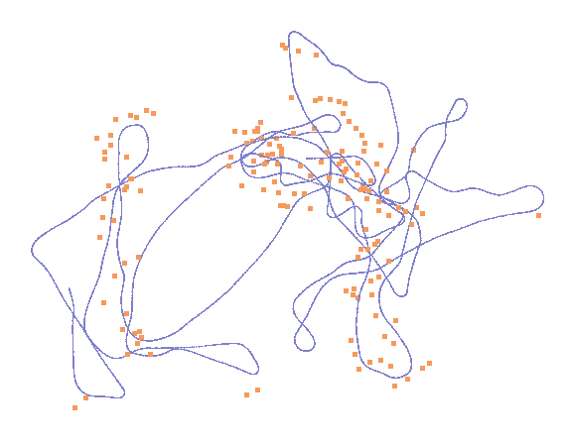
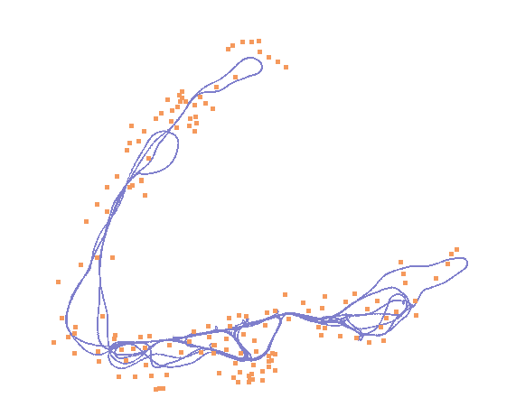
Robust SLAM with Our Method
Dynamic
Covariance
Scaling
Standard
Gauss- Newton
Victoria Park
Initialization
(Odometry)

Slide 32
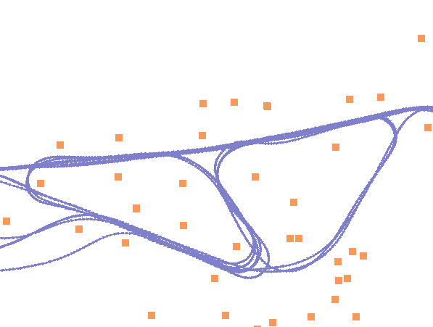
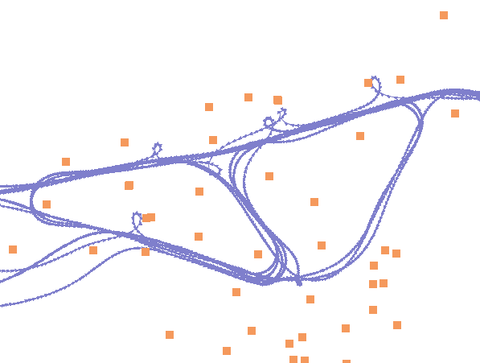
Robust SLAM with Our Method
Dynamic
Covariance
Scaling
Standard
Gauss- Newton

Slide 33
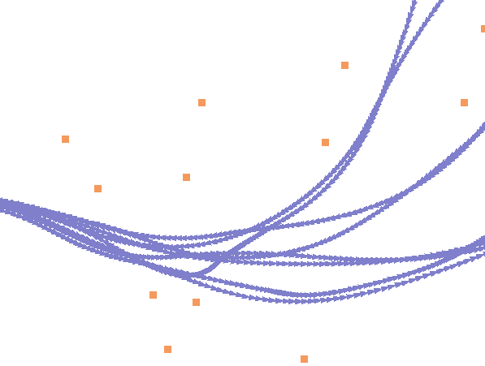
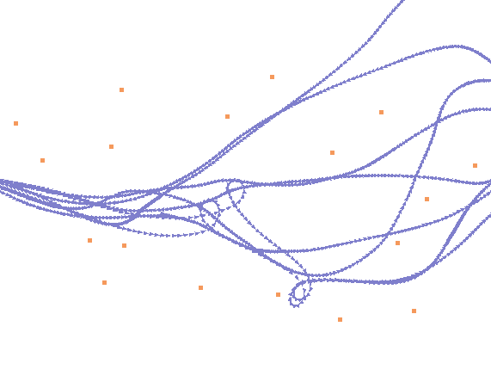
Robust SLAM with Our Method
Dynamic
Covariance
Scaling
Standard
Gauss- Newton

Slide 34
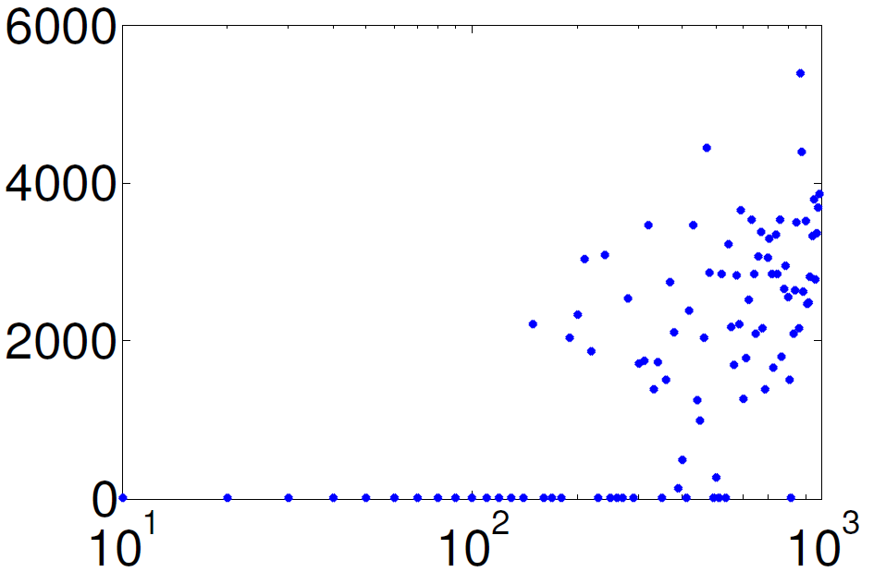
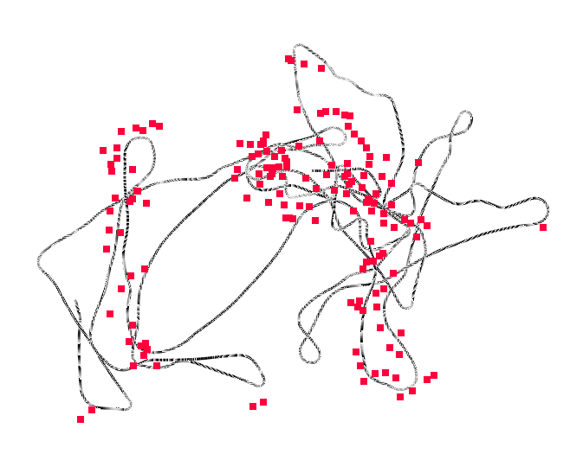
Dynamic Covariance Scaling with Outliers in Victoria Park
RPE
#Outliers
DCS recovers correct solution
GN fails to converge to the correct solution even for outlier-free case

Slide 35
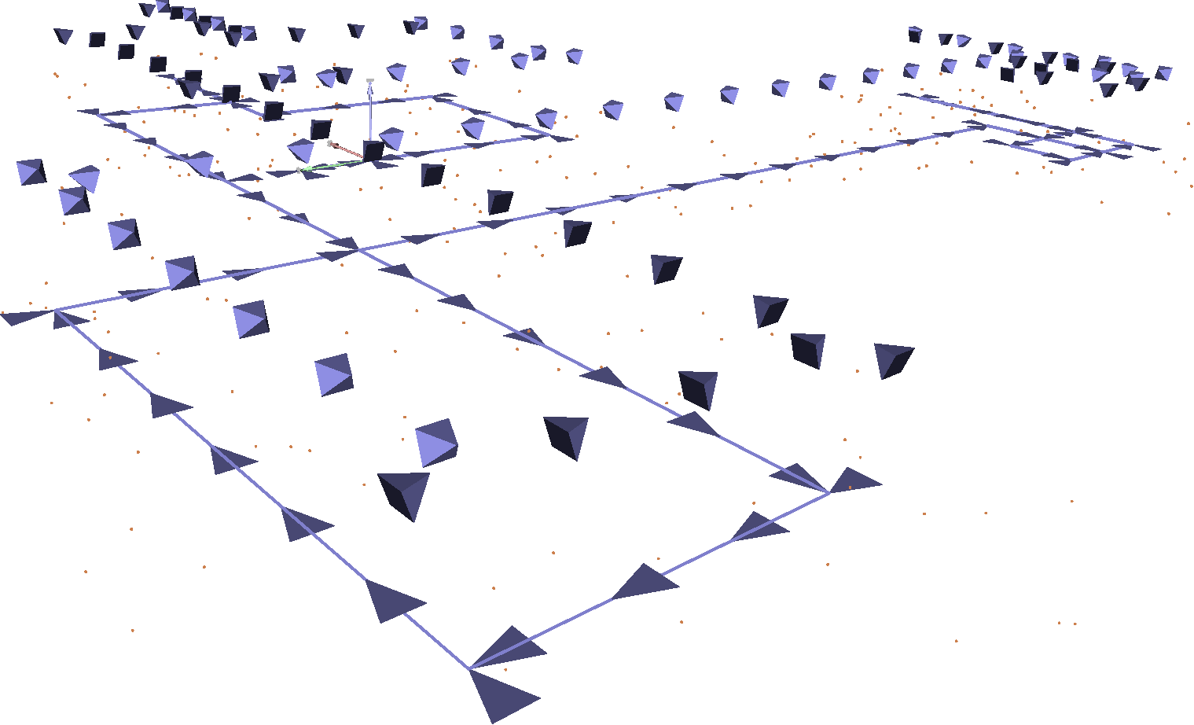
Robust Visual SLAM with Our Method
3D grid worlds of different sizes
Robot perceives point landmarks

Slide 36
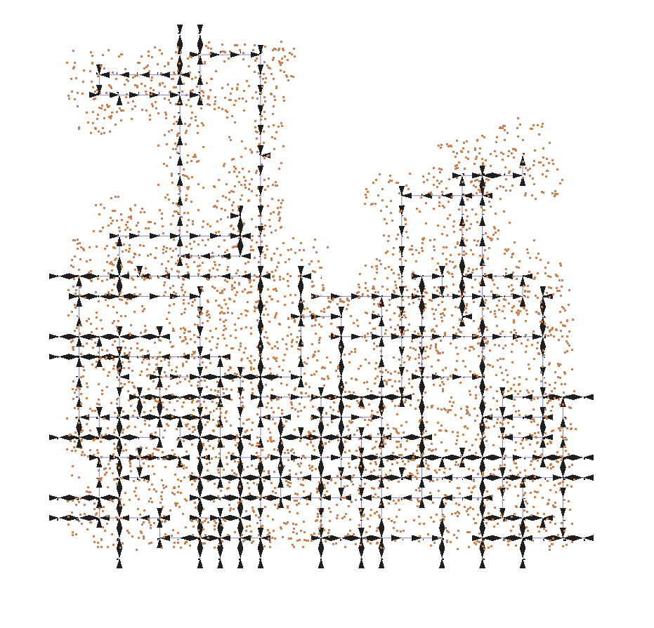
Robust Visual SLAM with Our Method
~1000 camera poses
~4000 features
~20K constraints
~5000 camera poses
~5000 features
~100K constraints

Slide 37
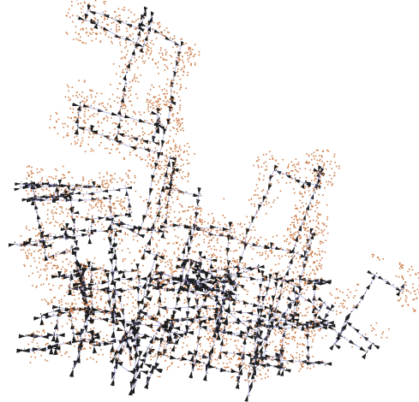
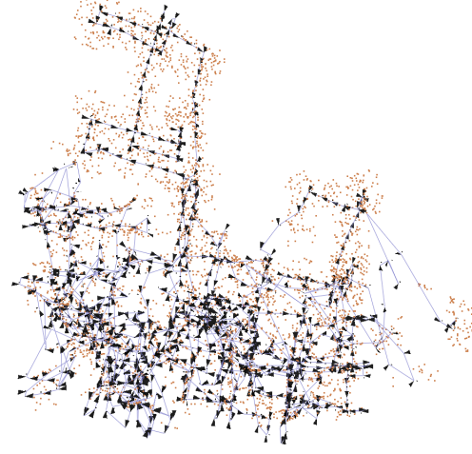
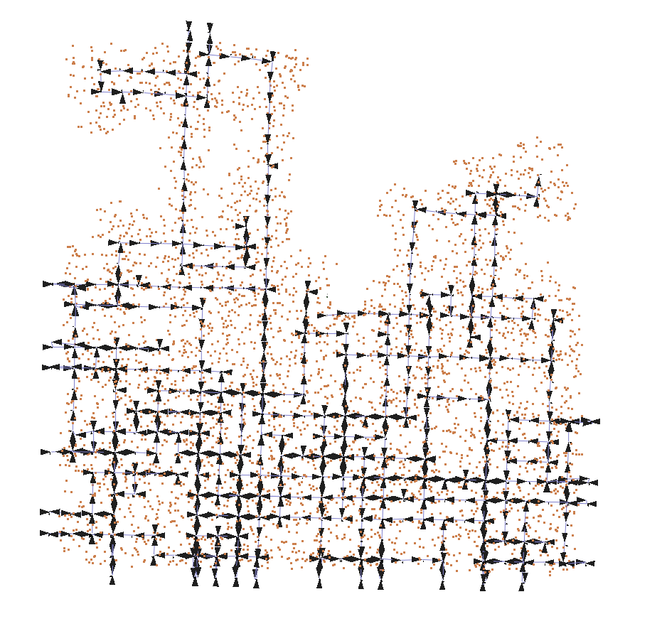
Robust Visual SLAM with DCS
Ground
Truth
Initialization
(Odometry)
Simulated Stereo
(Bad initial guess)
Levenberg-Marquardt
(100 iterations)
Our Method
(15 iterations)

Slide 38
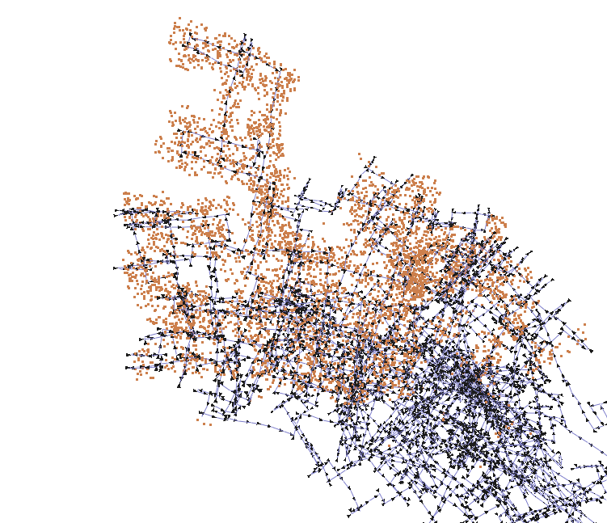
Robust Visual SLAM with DCS
Ground
Truth
Initialization
(Odometry)
Simulated Stereo
(Bad initial guess)
Levenberg-Marquardt
(150 iterations)
Our Method
(15 iterations)

Slide 39
Robust Visual SLAM with DCS
DCS recovers correct solution in the presence of up to 25% outliers
LM fails to converge to the correct solution even for outlier-free cases

Slide 40
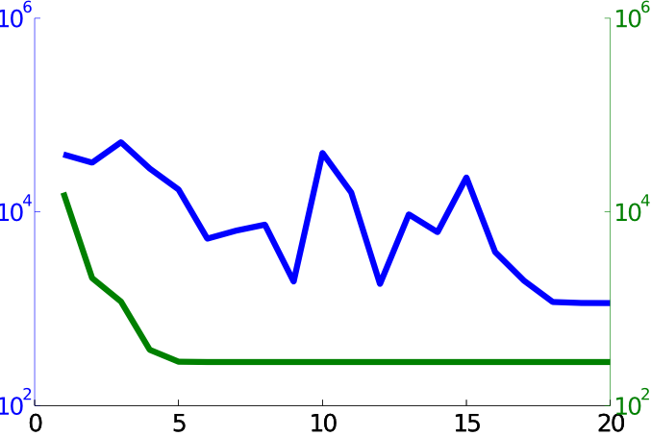
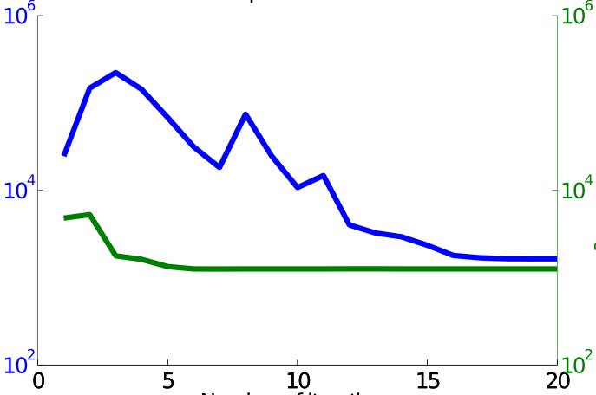
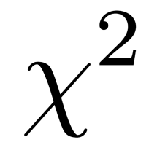
Convergence – 1000 Outliers
Switchable Constraints
Dynamic Covariance Scaling
Manhattan3500
Sphere2500
Iterations
Notes:
Align bullet – make a line smaller
Correct figure

Slide 41
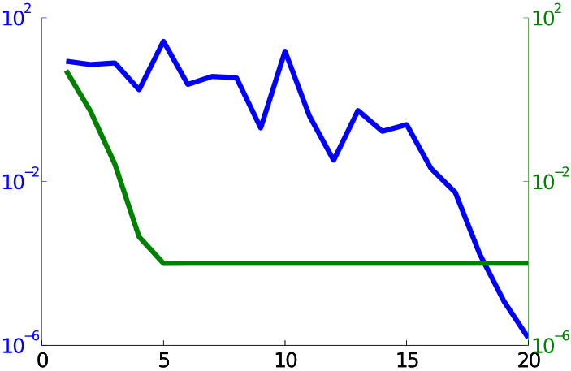
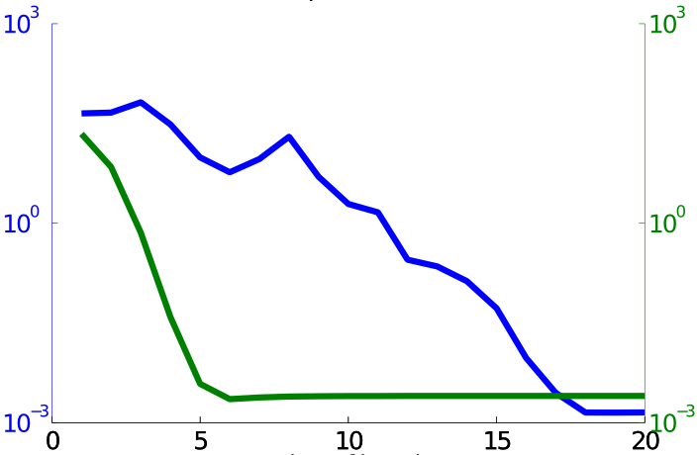
Convergence – 1000 Outliers
Switchable Constraints
Dynamic Covariance Scaling
Manhattan3500
Sphere2500
RPE
Iterations

Slide 42
Convergence with Outliers
Switchable
Constraints
Dynamic Covariance
Scaling

Slide 43
Conclusion
Rejects outliers for 2D & 3D SLAM
No increase in computational complexity
More robust to bad initial guess
Now integrated in g2o

Slide 44
Thank you for your attention!

Slide 45
Open Discussion:
Best way to compare?
Keep outliers/null hypothesis for DCS, SC, MM?
Standard for outlier datasets
Real, simulated
Online or batch?
Initialization
Odometry
Minimum Spanning Tree

Slide 46
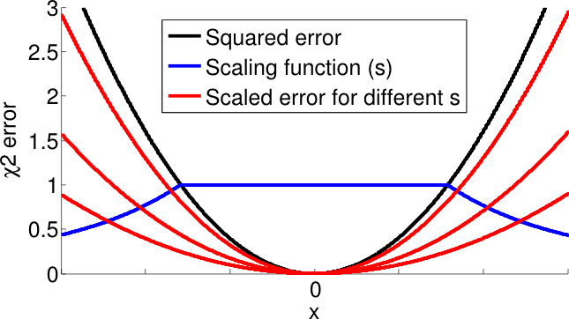
Questions?

