Slide 1
Robot Map Optimization using Dynamic Covariance Scaling
Pratik Agarwal, Gian Diego Tipaldi, Luciano Spinello, Cyrill Stachniss and Wolfram Burgard
University of Freiburg, Germany

Slide 2
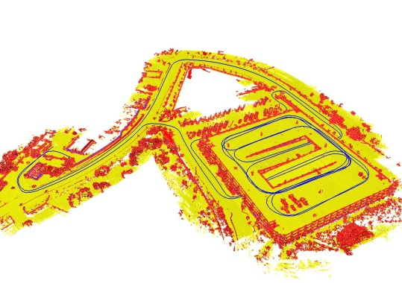
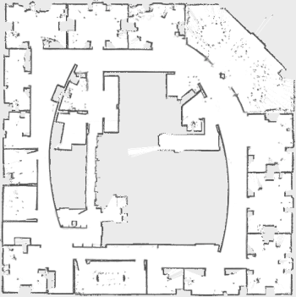
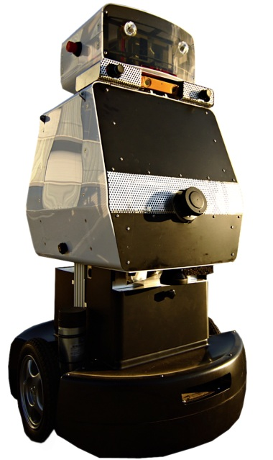
Maps are Essential for Effective Navigation

Slide 3
Graph-based SLAM
Robot pose
Constraint

Slide 4
Graph-based SLAM
Robot pose
Constraint

Slide 5
Graph-based SLAM
Robot pose
Constraint
a single outlier …

Slide 6
Graph-based SLAM
Robot pose
Constraint
a single outlier …

Slide 7
Graph-based SLAM
Vegas!!
Robot pose
Paris!!
Constraint
a single outlier …

Slide 8
Graph-based SLAM
Robot pose
Constraint
a single outlier … ruins the map

Slide 9
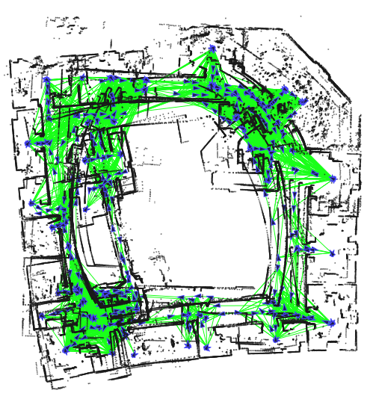
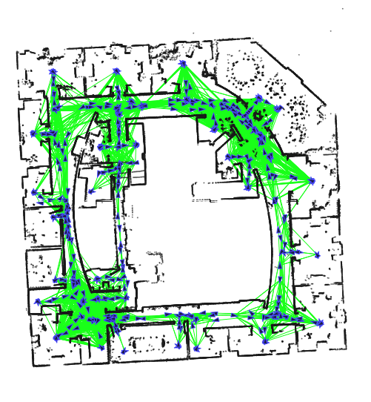
Graph-SLAM Pipeline
Front end Validation Back end
Assumption:
No
Outliers
Impossible to have perfect validation

Slide 10
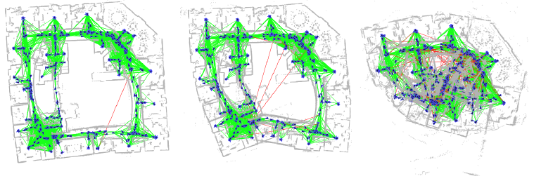
SLAM Back End Fail in the Presence of Outliers
1
Outlier
10
Outliers
100
Outliers
1
Outlier
10
Outliers

Slide 11
Why does the Mapping Fail?
Gaussian assumption is violated
Perceptual aliasing
Measurement error
Multipath GPS measurements

Slide 12
Why does the Mapping Fail?
Gaussian assumption is violated
Perceptual aliasing
Measurement error
Multipath GPS measurements
Alternative
Let the back end do the validation job!

Slide 13
Switchable Constraints
Recent approach by Sünderhauf and Protzel
Allows to switch off “bad” constraints
Requires a switch-variable per constraint
Additional switch-constraint per switch
Robust optimization in case of outliers but increased computational complexity
[Sünderhauf and Protzel, IROS 2012]

Slide 14
Standard Optimization
A
x
=
b

Slide 15
Switchable Constraints
A
x
b
A
x
=
b
=
s
Additional switch-variable per constraint
Additional switch-constraint per switch

Slide 16
Our Approach: Dynamic Covariance Scaling
Switch variables computed in closed form
Does not increase state space
Approximates Switchable Constraints
Is a robust M-estimator
Successfully rejects outliers

Slide 17
Standard Gaussian Least Squares

Slide 18
Dynamic Covariance Scaling

Slide 19
How to Determine s?

Slide 20
How to Determine s?

Slide 21
How to Determine s?
Check out the paper!
Notes:
Red line below
Put ij for chi and s

Slide 22
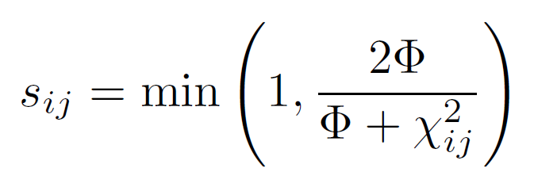
How to Determine s?
Check out the paper!
Closed form

Slide 23
How to Determine s?
. . .
Closed form

Slide 24
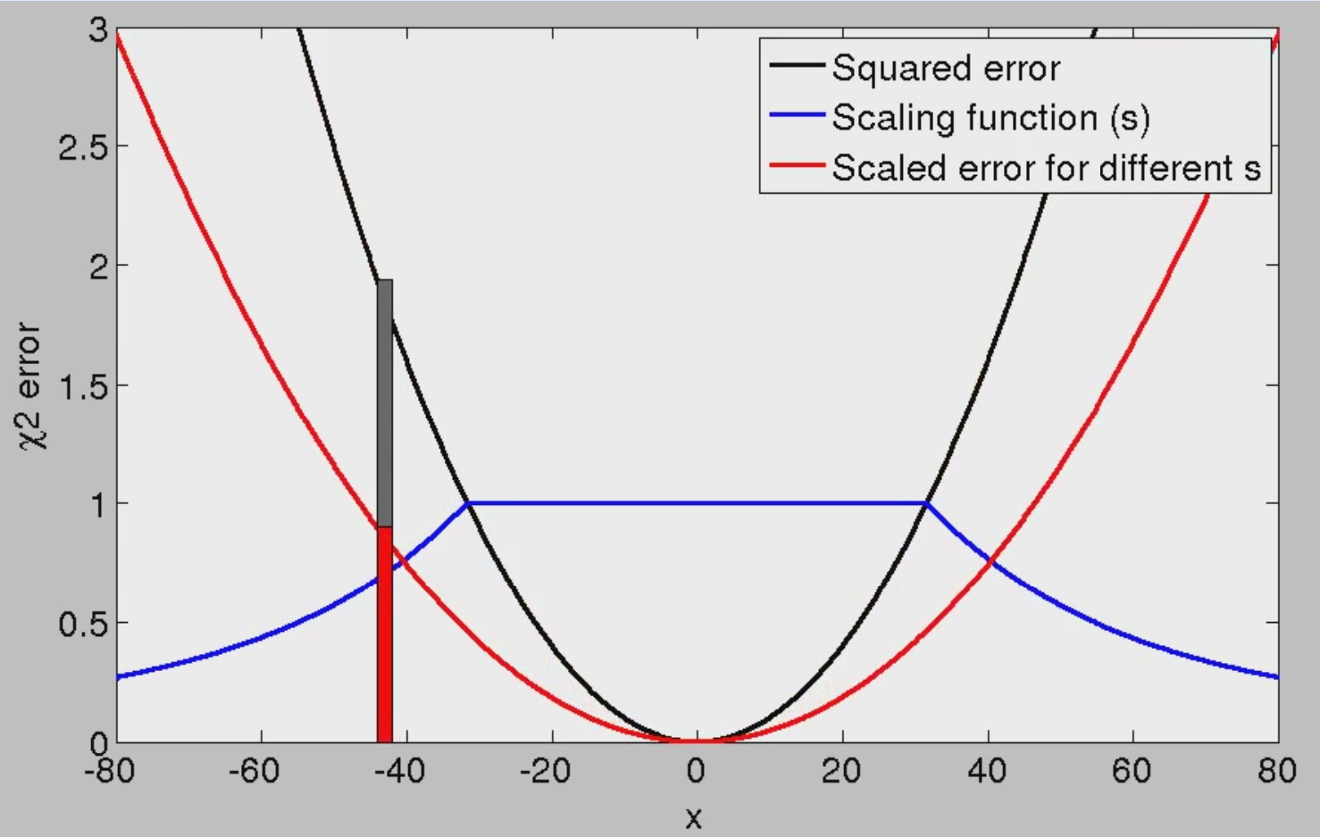
Dynamic Covariance Scaling

Slide 25
Dynamic Covariance Scaling
Both have
squared error

Slide 26
Dynamic Covariance Scaling
Original
error
Scaled
error

Slide 27
Dynamic Covariance Scaling
Linearization

Slide 28
Dynamic Covariance Scaling

Slide 29
Robust SLAM with Our Method
Ground
Truth
Initialization
Gauss
Newton
Our
Method
Sphere2500
(1000 Outiers)
Manhattan3500
(1000 Outiers)

Slide 30
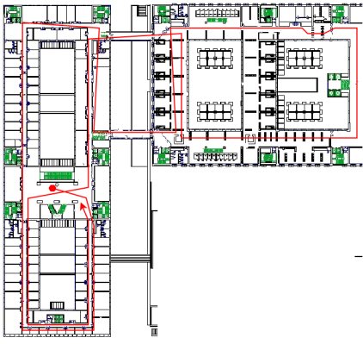
Dynamic Covariance Scaling with Front-end Outliers
Bicocca-multisession dataset

Slide 31
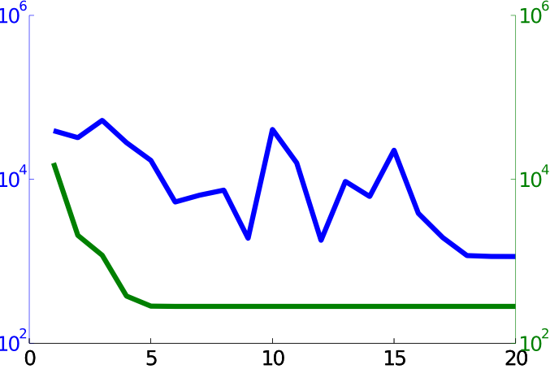
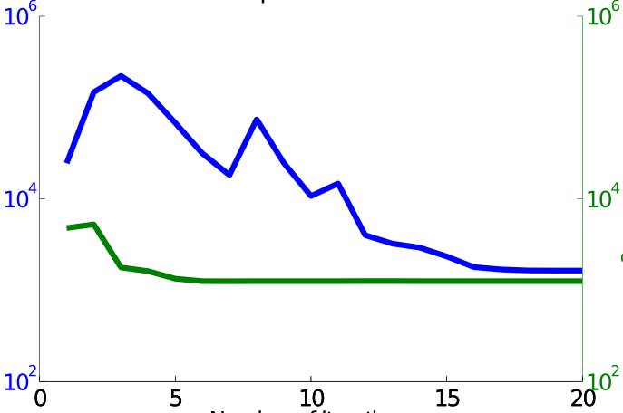
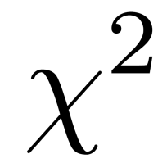
Convergence – 1000 Outliers
Switchable Constraints
Dynamic Covariance Scaling
Manhattan3500
Sphere2500
Iterations

Slide 32
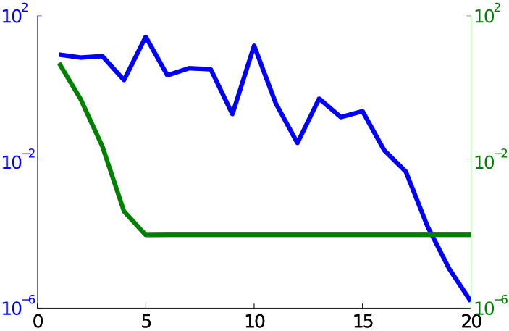
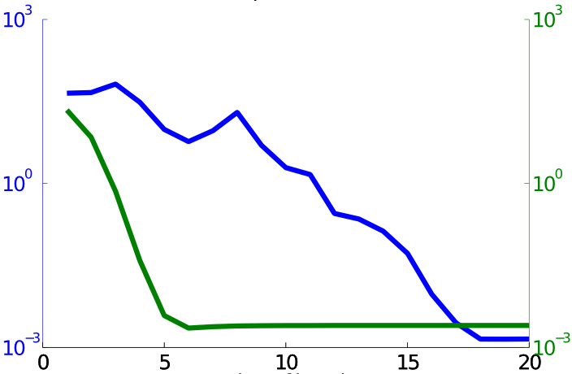
Convergence – 1000 Outliers
Switchable Constraints
Dynamic Covariance Scaling
Manhattan3500
Sphere2500
RPE
Iterations

Slide 33
Convergence – 1000 Outliers
Switchable Constraints
Dynamic Covariance Scaling
Manhattan3500
Sphere2500
RPE
$$10^{−3}$$
Iterations

Slide 34
Convergence with Outliers
Switchable
Constraints
Dynamic Covariance
Scaling

Slide 35
Conclusion
Rejects outliers for 2D & 3D SLAM
No increase in computational complexity
Approximates switchable constraints with a robust M-estimator
Now integrated in g2o

Slide 36
Thank you for your attention!

Slide 37
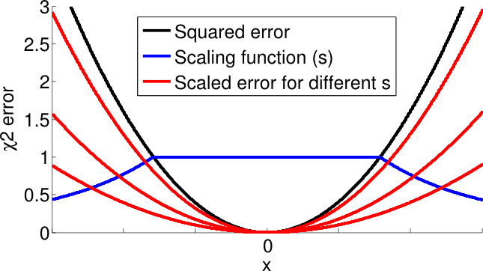
Questions?

